Slide 1
Unit testing

Slide 2
Table of contents
Introduction to testing
Code practice
Questions

Slide 3
What is Testing?

Slide 4
What is software testing?
A piece of code making sure that another piece of code is working correctly under a certain condition.

Slide 5
Why should you test?
Higher application quality (less bugs)
Easier refactoring
Easier version upgrades

Slide 6
Let’s consider a simple analogy

Slide 7


Slide 8


Slide 9
What de we mean by unit?

Slide 10
What do we mean by word unit?
Functions or Methods
Classes or Models
Modules or Packages:
Components: e.g. app in django
Notes:
In Django, you typically don't explicitly create "modules" in the same way you create apps or components. Instead, modules refer to the individual Python files within your Django app that contain code for specific purposes, such as models, views, forms, or utility functions. Each of these files serves as a module within your app.
Examples: models.py, forms.py, view.py etc.

Slide 11
Unit testing
Testing one piece independently of other pieces
Faster to run

Slide 12
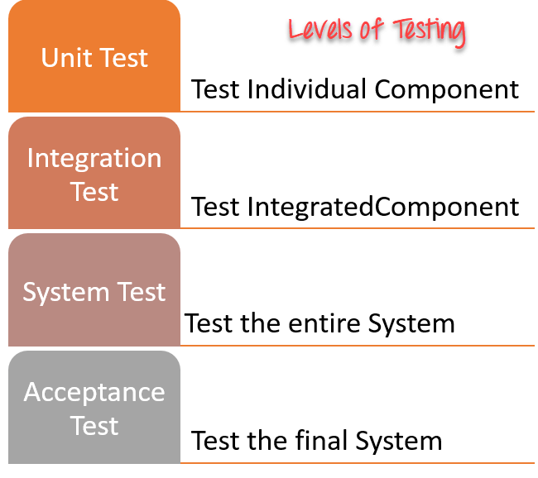
Levels of software testing

Slide 13
Unit testing:
The aim is to test each part of the software by separating it. It checks that component are fulfilling functionalities or not.
This kind of testing is performed by developers.
Integration testing:
Test multiple pieces together to assure that they work well with one another.
This kind of testing is performed by testers.

Slide 14
System Testing
System testing is performed on a complete, integrated system.
It tests the overall interaction of components.
It involves load, performance, reliability and security testing. (non-functional)
System testing most often the final test to verify that the system meets the specification. It evaluates both functional and non-functional need for the testing.
Acceptance testing:
Acceptance testing is a test conducted to find if the requirements of a specification or contract are met as per its delivery.
Acceptance testing is basically done by the user or customer

Slide 15
Let’s code it!

Slide 16
Covergae library
Install: $ pip install coverage
Create folder test in your app
Add test_views.py, test_models.py
Add __init__.py to your tests folder to tell the Django test runner that our code of testing exists in that folder
Run coverage tests: Coverage manage.py run test <app_name>
Add coverage html: coverage html
Open index.html in the new created folder

Slide 17
Exercise
Considering ‘BlogsUnitTesting’ project
Create app named ‘blogs’
Create model ‘Post’ in your app with the following attributes:
‘author_name’, ‘title’, ‘content’
Add __str__ method to print the contents of the object

Slide 18
Any questions?

